Slide 1
Azure Messaging
Standards Matter!
Clemens Vasters Principal Architect – Azure Messaging, Microsoft @clemensv OASIS AMQP Technical Committee Chair OASIS MQTT TC Member CNCF CloudEvents Architect OPC UA PubSub Architect
Service Bus
Event Hubs
Event Grid
Relay
IoT

Slide 2
Agenda
What are the Azure Messaging services?
Messaging Patterns and Protocol Characteristics
Push/Pull, Queues, Ingestors/Streams, Routers/Distributors
Messaging Protocol Standards
MQTT, AMQP, HTTP, Kafka, gRPC
Encoding Standards
XML, CSV, JSON, CBOR, Avro, Thrift, Protobuf
Abstraction Standards
OPC UA, CNCF CloudEvents, JMS 2.0

Slide 3





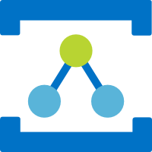
Azure Eventing and Messaging Core Services
Push-style distribution of discrete events to serverless workloads
Event Grid
HTTP (AMQP/WS)
Message Oriented Services
Pull-style, queue-based transfer of jobs and control via message queues and topics
Service Bus
HTTP AMQP/WS
Partitioned, high-volume, tape-drive-style sequential recording and unlimited, pull-style re-reads of event streams.
Event Hubs
HTTP AMQP/WS KRPC
Discovery and connectivity service for securely bridging streams across network boundaries in hybrid edge/cloud scenarios.
Connectivity Services
Relay
WS

Slide 4

Service Bus Architectural Patterns
Assignment of work with load-aware balancing
Load-leveling for “spiky” workload traffic shapes
Transactional, once-and-only-once processing
Multiplex handling of in-order message sequences
Deduplication, deferral, and “poison” handling
Queues
HTTP AMQP/WS
All of the above, plus:
Copies to 100s of concurrent subscribers
Filter rules and message markup
Message routing
Topics
HTTP AMQP/WS
Service Bus is a “swiss army knife” for messaging-driven workloads.

Slide 5
Event Hubs Architectural Patterns
Ingestion and storage of large event streams
> 2 Gigabyte per second if required
Separation of event streams into partitions
Client-chosen offsets into event stream allow arbitrary reads and re-reads during retention
Retention of raw event data from 1 up to 90 days
Automated archival into Avro containers for subsequent batch-style processing
Publisher policies for data origin attestation and access control
Event Hub (IoT Hub)
HTTP AMQP/WS KRPC (Kafka)
Event Hubs is a high-scale, high-availability, multi-protocol event stream engine used for collecting and consolidating events for real-time analytics and other high-throughput computations

Slide 6
Event Grid Architectural Patterns
Ingestion and push-style distribution of discrete events (events not correlated into streams) to interested subscribers.
Per-subscriber application of simple and complex filters to select particular events of interest
Abuse protection for event publishers
Event schema mapping and support for CNCF CloudEvents 1.0 standard and bindings
Multitenancy support for SaaS applications.
Simple integration with a catalog of available event sources and sinks.
Event Grid
HTTP AMQP/WS
Event Grid is the Azure-wide eventing backplane for distributing and handling discrete events raised at the platform level, by custom applications, and by partner platforms.

Slide 7
Messaging Patterns

Slide 8
Jobs and Commands
Events
Intents
Facts
Expectations
History
Conversations
Context
Contracts
Order
Control Transfer
Value Transfer

Slide 9
Jobs and Commands
Events
A
B
A
?
C
?
One message, one receiver
One event, 0 to many receivers

Slide 10
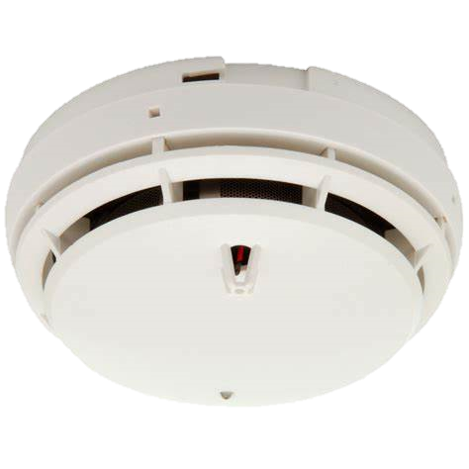
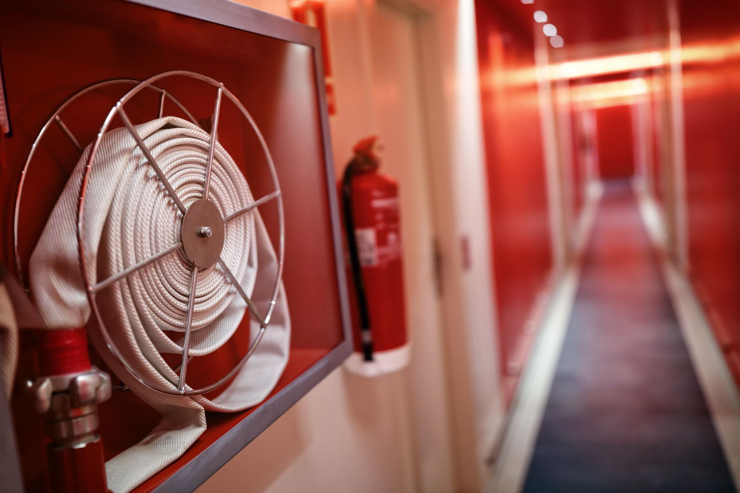
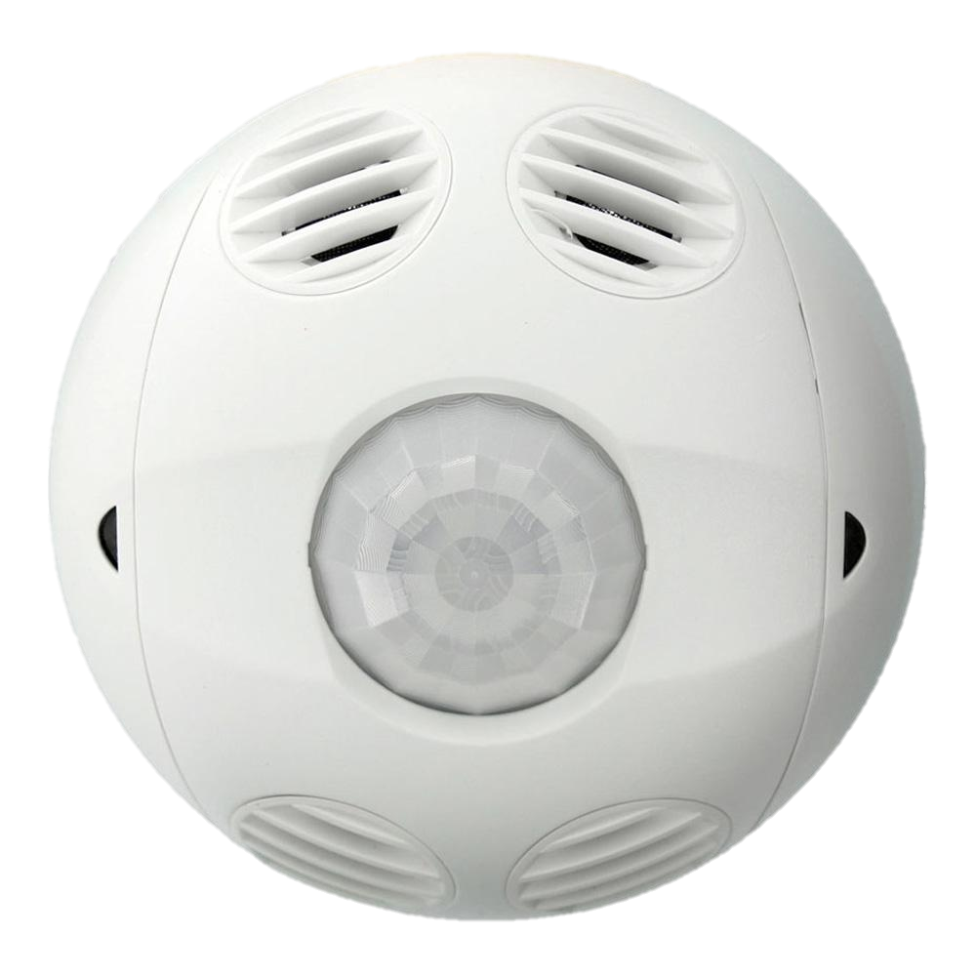
Events: Observations, Signals, Jobs
Signals are immediately actionable
Signal? Job? Is there an expectation to fulfill?
Fire Smoke
Signal
Fire Alarm!
Action(s)
Average crossed threshold
Action(s)
Climate: Temperature Humidity
Derivative signals are computed from sequences of observations
Signal
Observations
Time

Slide 11

1:1 Patterns
HTTP & RPC
Peer-to-Peer
Brokered
Source
Unidirectional Push
Target
Source
Inter-mediary
Target
Via Proxy
Source
Inter-mediary
Target
Source
R/R
Target
Source
Inter-mediary
Target
Via Queues
Unidirectional Pull
Source
Target
Source
Inter-mediary
Target

Slide 12
1:N Patterns
Target
Target
Broadcast
(everyone)
Multicast
(conditional)
Source
Inter-mediary
Target
Source
Inter-mediary
Target
?
?
?
Target
Target
Event Distribution
Event Distribution
Target
Source
Inter-mediary
Target
Job & Command Dispatch
Target
Anycast
(one of the eligible)

Slide 13













Beyond a single hop: Event Journeys
Device Status Change or Alarm
CO PPM over threshold
Web site visitor statistics
Advertisement clicked
Package delivery
Package scanned

Slide 14
Symmetry
Client
All Gestures
Server
All Gestures
A protocol is symmetric when is allows all of its supported gestures (except for connection establishment) independent of who initiated the connection.

Slide 15
Multiplexing
Client
Connection
Server
Session 1
Session 2
Multiplexing allows a singular network connection to be used for multiple concurrent communication sessions (or links)
Establishing connections can be enormously costly, multiplexing saves the effort for further connections between parties

Slide 16
Framing, Encoding, Data Layout
Framing
Encoding
Layout
Frame "header"
11001100111001010101010111000100100010001010010011110001001010001001010010101010001001010011001010010011010101001100100101010100101000101010100100101010101010100101001010101001
JSON
Avro
Msg Pack
Frame "body"
XML
AMQP
CSV
Proto
Text
Raw
A message or framing protocol splits the data stream into distinct chunks that can be processed in sequence or separately.
A frame/message header contains information about the size, content, destination, and often also an expression of the the sender's intent
The encoding (or media-type) tells a message processor how to interpret the payload data of the message.
A data layout convention can tell a processor how to deal with structured data in a dynamic fashion to distinguish objects or rows/columns

Slide 17
Metadata
Framing
Metadata
Frame "header"
11001100111001010101010111000100100010001010010011110001001010001001010010101010001001010011001010010011010101001100100101010100101000101010100100101010101010100101001010101001
Protocol Metadata
Information immediately defined by and required by the protocol to function
Frame "body"
Not all protocols allow for payload and application metadata, requiring externally agreed conventions establishing mutual understanding of message content
Payload Metadata
Information describing size, encoding, and other aspects of the payload (language)
Application Metadata
App specific instructions sent alongside the payload for observation by the receiver
A message or framing protocol splits the data stream into distinct chunks that can be processed in sequence or separately.
A frame/message header contains information about the size, content, destination, and often also an expression of the the sender's intent

Slide 18
Transfer Assurances
Connection
Unreliable
Reliable Transfer Session
Reliable protocols allow transfer of frames more reliably than underlying protocol layers
Compensating for data loss, preventing duplication, ensuring order
Various strategies to compensate for data loss
Resend on negative acknowledgment („data didn‘t get here“)
Resend on absence of acknowledgment
Send duplicates of frames
Common Transfer Assurances
"Best Effort" or "At Most Once" – no resend, not reliable
"At Least Once" – frame is resent until it is understood that is has been delivered at least once
"Exactly Once" – frame is delivered exactly once [see next]

Slide 19
Application Protocols and APIs
Standards

Slide 20
Our Standardization Engagement Principles
Open door development whenever possible (ex. W3C, CNCF)
Develop in public
Share with public
Work product royalty free
Consortium standards orgs case-by-case (ex. OASIS, OPC UA)
Develop in private
Share with public when finalized
Work product royalty free or RAND at minimum
Standards are not useful unless they’re broadly accessible to anyone interested in implementing or otherwise working with them.

Slide 21
Why should YOU care?
Betting on standards.
Using a common, standardized message model increases the interoperability between parts of your own applications.
The CloudEvents project already did the work of figuring out what the essential attributes of an event are and how those best map to common transports and protocols
Using standard APIs makes it easier to switch between broker products, e.g. migrate from on-premises to the cloud
Using standard protocols allows tapping into a broad ecosystem of client software for most runtimes and accommodates many frameworks.

Slide 22
What is a Protocol?
A (network-) protocol defines rules and conventions to allow flow of information from some party to another party (and back, sometimes)
Making information flow between parties can get very complicated, so the job of making that happen is split up into layers that each focus on specific aspects, such as representing bits as radio waves.
The layers usually compose such that higher, more abstract concepts provide a choice of which lower layer to leverage, like Internet protocol routing over wired connections or radio.

Slide 23
Application Protocols
MQTT
HTTP
AMQP
CoAP
CloudEvents, AllJoyn, Thread, Weave, LWM2M, OPC UA, etc…
GRPC
App
TLS / DTLS
QUIC
TCP
UDP
ICMP SCTP
Non-IP Routed Networks (e.g. GSM/UMTS, X.25, Frame Relay)
IP, IPSEC, L2TP
Net
GSM/GPRS/HSPA/LTE
Weightless
White WiFi 802.11af
Zigbee IEEE 802.15.4
Bluetooth IEEE 802.15.1
Link
WiFi IEEE 802.11x
ATM
Ethernet IEEE 802.3 + TSN
PowerLAN/Homeplug

Slide 24
HTTP 1.1
Patterns | ReqResp
Symmetric | No
Multiplexing | No
Encodings | Variable
Metadata | Yes
Assurances | -
HTTP 1.1 is the Application Protocol for the web
Simple structure, text based, ubiquitious
Client-initiated (asymmetric) request/response flow
No multiplexing
HTTP embodies the principles of "Representational State Transfer".
REST is not a protocol, it's the architectural foundation for the WWW.
Client
TCP Connection (w/ TLS for HTTPS)
Server
POST /search HTTP/1.1 Content-Type: application/json
Content-Length: 21 { "query" : "hello" }
HTTP/1.1 200 OK Content-Type: application/json Content-Length: xxx { "result" : "…"}

Slide 25
Web Sockets
Patterns | Duplex
Symmetric | No
Multiplexing | No
Encodings | Fixed
Metadata | No
Assurances | -
Web Sockets is a Stream Tunneling Protocol
Allows using the HTTP 1.1 port (practically only HTTPS) for bi-directional, non-HTTP stream transfer
Web Sockets by itself is neither a Messaging or an Application Protocol, as it defines no encoding or semantics for the stream.
Web Sockets can tunnel AMQP, MQTT, CoAP/TCP, etc.
Client
Web Socket
TCP Connection (w/ TLS for HTTPS)
Server
GET /chat HTTP/1.1 Host: server.example.com Upgrade: websocket Connection: Upgrade
HTTP/1.1 101 Switching Protocols Upgrade: websocket Connection: Upgrade
Data Frames
Handshake

Slide 26
HTTP/2 (+ GRPC)
Patterns | RR, OW/SC
Symmetric | No
Multiplexing | Yes
Encodings | Variable
Metadata | Yes
Assurances | -
HTTP/2 is an Application Protocol; successor of HTTP 1.1
Same semantics and message model, different implementation
Multiplexing support, binary standard headers, header compression.
Uses Web Socket like upgrade for backward compatible integration with HTTP 1.1, no WS support
Server-push support (server can send unsolicited replies)
Credit based flow control
Stream
Stream
Client
TCP Connection (w/ optional TLS ) → HTTP 1.1
Server
HTTP/2
Stream
GET /chat HTTP/1.1 Host: server.example.com Upgrade: h2c Connection: Upgrade, HTTP2-Settings
HTTP/1.1 101 Switching Protocols Upgrade: h2c Connection: Upgrade
HTTP/2 Frames
Upgrade

Slide 27
HTTP/3
Patterns | RR, OW/SC
Symmetric | No
Multiplexing | Yes
Encodings | Variable
Metadata | Yes
Assurances | -
HTTP/3 is an Application Protocol; coexists with HTTP/2
Same semantics and message model, different implementation
Largely a redo of HTTP/2, moving to QUIC
Multiplexing support via QUIC (UDP Streams), binary standard headers, header compression.
QUIC runs over UDP port 443. TLS built in.
Stream
Stream
Client
QUIC UDP
Server
HTTP/3
Stream
QUIC Frames

Slide 28
OASIS MQTT
MQTT is a lightweight Publish and Subscribe Protocol
Easy to implement for publishers and subscribers, assumes broker
Rigorously optimized for minimizing wire overhead
Publish/Subscribe gestures are explicit elements of the protocol; “subscribe” = “receive”
Often used for submitting and subscribing to telemetry and sharing state changes amongst peers, can model request/reply routes on top
MQTT 3.1.1 most used
MQTT 5.0 new with many improvements
MQTT Broker
SUBSCRIBE /a
PUBLISH /a
PUBLISH /b
PUBLISH /a
Topics

Slide 29
OASIS AMQP Advanced Message Queuing Protocol
AMQP 1.0 is a symmetric, reliable Message Transfer Protocol with support for multiplexing and flow control
Supports queuing, pub/sub, filters, one-way, request-response, streams
No topology assumptions, multi-hop routing facilities
AMQP 0.9 (what RabbitMQ uses) is an expired draft with a fixed topology model
A
Connection + Session
B
Link
Link Credit
-1
-1
-1
-1
-1
+5

Slide 30
Azure Compatible, Generic AMQP 1.0 Clients
Client Stack | URL
Apache Qpid Proton-C (Go, Python, Ruby, C++) | https://qpid.apache.org/proton/
Apache Qpid Messaging API | https://qpid.apache.org/components/messaging-api
Apache Qpid Proton-J | https://qpid.apache.org/proton/
Apache NMS AMQP | https://activemq.apache.org/components/nms/providers/amqp/
AMQP .NET Lite (all variants of .NET, incl. Nano & Micro) | https://github.com/Azure/amqpnetlite
Azure AMQP (our own server stack) | https://github.com/Azure/azure-amqp
Azure uAMQP C (Python, PHP) | https://github.com/Azure/azure-uamqp-c https://github.com/Azure/azure-uamqp-python
Rhea (NodeJS) | https://github.com/amqp/rhea
Go AMQP | https://github.com/Azure/go-amqp
Vert.X AMQP Client | https://vertx.io/docs/vertx-amqp-client/java/

Slide 31
Apache Kafka
Patterns | Kafka
Symmetric | No
Multiplexing | No
Encodings | Variable
Metadata | Yes
Assurances | ALO
The Apache Kafka protocol is a project-specific request/response protocol for the Apache Kafka broker
SASL preamble for authentication
API keys identify operations, specific message types per key
Effectively an RPC protocol tailored to Kafka’s features
Not a standard and fully controlled by the Kafka project, but quite popular
Producer
Apache Kafka Broker
Consumer
produce
fetch

Slide 32
Apache Kafka® Clients
JVM & C library bindings
Direct implementations of the Apache Kafka® wire protocol.
https://cwiki.apache.org/confluence/pages/viewpage.action?pageId=30736606
Clojure / kinsky (Exoscale)
Java/JVM (Apache project)
Apache Kafka® API
C++ librdkafka (M. Edenhill/Confluent)
Python (Confluent)
Python/Kafka-Python (Dana Powers, Flexport)
Azure Event Hubs is compatible with the producer and consumer APIs of all current Apache Kafka clients.
Go (Confluent)
Golang/Sarama (Shopify)
.NET (Confluent)
Erlang/Brod (Klarna AB)
Node /node-rdkafka (Blizzard)
Azure Event Hubs
Ruby/Ruby-Kafka (Zendesk)
PHP /php-rdkafka (Arnaud Le Blanc)
Ruby / Karafka (Karafka/Coditsu)
Only the Java/JVM client is part of the Apache Kafka project. All other clients are under various non-foundation ownerships and licenses. Azure does not provide QFE support for any of these clients but does provide support for service-side compatibility.
Rust /rust-rdkafka (Federico Giraud,Google)
Ruby / Karafka (Karafka/Coditsu)
Lisp /cl-rdkafka (Sahil Kang)
Node / kafka-node (SOHU-Co, CN)
… Swift, Tcl, Perl, OCaml, Node, Lua, Haskell, D, …
Apache Software Foundation
Non-Foundation, Community / Best Effort Support
Perl / Kafka (TrackingSoft)
Non-Foundation, Commercial Support Option

Slide 33
Unifying Abstractions

Slide 34
Java JMS 2.0 (Jakarta Messaging)
An exceptionally successful Java/JVM API standard that works with most mature, queue-based pubsub message brokers on the market today.
Queues
Topics
JMS Message Selectors
Shared Durable Subscriptions
Unshared Durable Subscriptions
Shared Volatile Subscriptions
Unshared Volatile Subscriptions
Queue Browser
Queue Message Selectors
Temporary Queues
Temporary Topics
JMS Transactions
Topic topic = session.createTopic(dest.toString());
MessageProducer sender = session.createProducer(dest);
TopicSubscriber topicSubscriber1 = session.createDurableSubscriber(topic, sub1Name);
TopicSubscriber topicSubscriber2 = session.createDurableSubscriber(topic, sub2Name, "JMSCorrelationID='5'", false);
MessageConsumer topicSubscriber3 = session.createSharedDurableConsumer(topic, sub3Name, "JMSCorrelationID='5'");
TextMessage message = session.createTextMessage("Text!");
message.setJMSCorrelationID(Integer.toString(i));
sender.send(message, DELIVERY_MODE, Message.DEFAULT_PRIORITY, Message.DEFAULT_TIME_TO_LIVE);

Slide 35
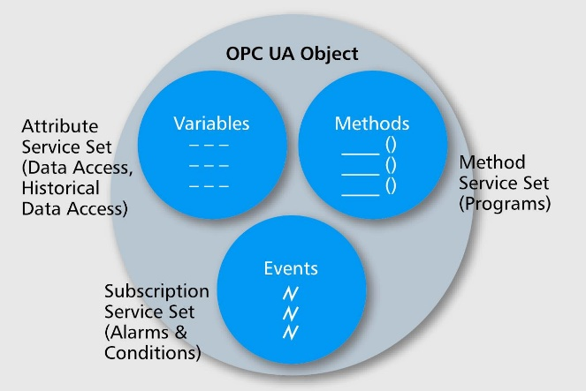
OPC UA OPC Foundation Unified Architecture
OPC Foundation standard; IEC standard
Foundational architecture model for (industrial) device management and information flow
Cloud integration via Pub/Sub
Address Space
Server
Client
Discover Observe Query Control

Slide 36
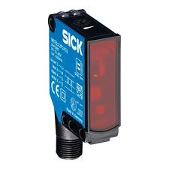
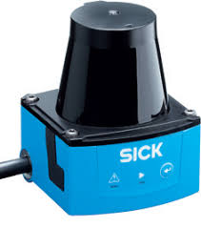
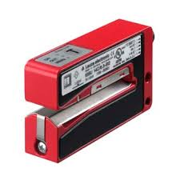
Device
Capabilities
OPC UA Server
“Message Writer”
Address Space
Published Items
Data (Query)
Data (Query)
Encoding
OPC UA
Event
Msg Security
Event
Transport
Hard Real Time Bus. Not IP.
Event is written out here
Perimeter Boundary
Information is captured here.
Plant Integrator System
Operator System
DIN 92222
Machine A Manufacturer System
Machine B Manufacturer System
Component Manufacturer System
Federation

Slide 37

CNCF CloudEvents
Event Protocol Suite developed in CNCF Serverless WG
Common metadata attributes for events
Flexibility to innovate on event semantics
Simple abstract type system mappable to different encodings
Transport options
HTTP(S) 1.1 Webhooks, also HTTP/2
MQTT 3.1.1 and 5.0
AMQP 1.0
Kafka, NATS
Encoding options
JSON (required for all implementations)
Extensible for binary encodings: Avro, AMQP, etc.

Slide 38

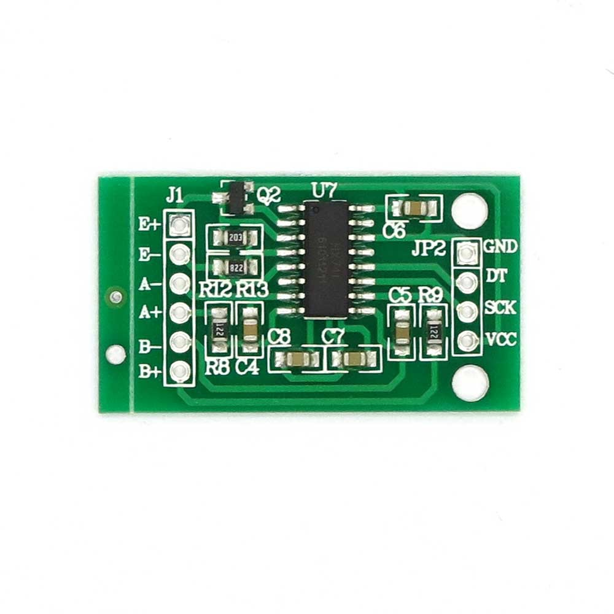





Why CloudEvents?
HTTP
Cloud Stream Analytics
IoT Field Gateway
Avro
Event Stream Broker
JSON
NATS, Kafka, AMQP
Kafka, AMQP
MQTT
Telemetry
Telemetry Alerts
JSON
Functions & Services
HTTP
HTTP
Data Lakes
Alerts
Pub/Sub & Queues
NATS, MQTT, AMQP
AMQP, NATS
Alerts
Event data is often routed via multiple hops and often using different protocols
How is what gets sent here easily routed to and stored here in hybrid edge/cloud and multi-cloud systems?

Slide 39
Why CloudEvents?
CloudEvent
Binds to existing standard application protocols
Does not try to abstract away protocols but leverages each for its strengths
Integrates with existing messaging and eventing stacks
Leverages existing data encodings and is easy to adapt to new ones (Protobuf, CBOR, MsgPack, etc.)
Allows for protocol switching and transcoding on multi-hop routes
Common Context Attributes
Event Data
Common and User Defined Extension Attributes
“structured” projection onto self-contained data structure using standard encodings (easily routable, storable as-is)
“binary” direct projection onto protocol message (most efficient protocol use)
structured data encodings (extensible)
AMQP
Avro
JSON
application protocol mappings (extensible)
AMQP
HTTP
NATS
Kafka
MQTT

Slide 40
CloudEvents - Base Specification
CloudEvents is a lightweight common convention for events.
It’s intentionally not a messaging model* to keep complexity low.
No reply-path indicators, no message-to-message correlation, no target address indicators, no command verbs/methods.
Metadata for handling of events by generic middleware and/or dispatchers
What kind of event is it? type, specversion
When was it sent? time
What context was it sent out of? source, subject
What is this event’s unique identifier? id
What’s the shape of the carried event data? datacontenttype, schema
Event data may be text-based (esp. JSON) or using some binary encoding
CloudEvent
Common Context Attributes
Event Data
Common and User Defined Extension Attributes

Slide 41
Event Formats
Event formats bind the abstract CloudEvents information model to specific wire encodings.
All implementation must support JSON. Avro is a supported binary format.
Further compact binary event format candidates might be CBOR, or Protobuf.
{ "specversion" : "1.0", "type" : "myevent", "source" : "uri:example-com:mydevice", "id" : "A234-1234-1234", "time" : "2018-04-05T17:31:00Z", "datacontenttype" : "text/plain", "data" : "Hello" }
JSON Representation

Slide 42
Example
HTTP - Binary
POST /event HTTP/1.0
Host: example.com
Content-Type: application/json
{
"action": "newItem",
"itemID": "93"
}
HTTP - Structured
POST /event HTTP/1.0
Host: example.com
Content-Type: application/cloudevents+json
{
"specversion": "1.0",
"type": "com.bigco.newItem",
"source": "http://bigco.com/repo",
"id": "610b6dd4-c85d-417b-b58f-3771e532",
"datacontenttype": "application/json",
"data": {
"action": "newItem",
"itemID": "93"
}
}
ce-specversion: 1.0
ce-type: com.bigco.newItem
ce-source: http://bigco.com/repo
ce-id: 610b6dd4-c85d-417b-b58f-3771e532

Slide 43
Transport Bindings
HTTP 1.1, HTTP/2, HTTP/3:
Binds to the HTTP message
Binary and structured modes
AMQP:
Binds event to the AMQP message
Binary and structured modes
MQTT:
Binds event to MQTT PUBLISH frame.
Binary and Structured for MQTT v5
Structured mode only for MQTT v3.1.1
NATS:
Binds event to the NATS message.
Structured mode only
Apache Kafka:
Binds to the Kafka message
Structured and binary mode
Protocol bindings directly map onto the protocol‘s message structure and using protocol semantics. Accepts that protocols are different.
Binary mode: Event metadata projected onto the protocol message metadata, event data onto the protocol message payload
Structured mode: Event is self-contained as an encoded byte stream, metadata may be promoted (duplicated) into protocol message metadata.

Slide 44
Cloud Events Futures
Discovery, Catalog, Subscriptions

Slide 45




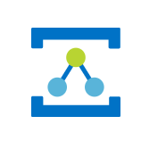
Service Bus & Azure Queues
Event Hubs
Event Grid
IoT Hub
Relay
Cloud messaging
Telemetry stream ingestion
Event distribution
IoT messaging and manage-ment
Discovery, Firewall/NAT Traversal
AMQP
AMQP
AMQP
AMQP
HTTP
HTTP
HTTP
MQTT
Web-Sockets
HTTP
Kafka
Cloud-Events
OPCUA
Cloud-Events
Cloud-Events
Cloud-Events
Cloud-Events
JMS 2.0
Microsoft Azure

